Slide 2
How multiscreen consumption is changing
Ampere Analysis
July 2016

Slide 3
UK media features a diverse set of companies and business models
Source: Ampere Analysis calculations based on company reports, proprietary research, Group M, IAB UK data

Slide 4
Within a few years, online advertising will have overtaken pay TV

Slide 5
SVoD-only homes are growing rapidly across the Western World
Average 2016
Average 2015
Source: Ampere Consumer, SVoD only includes SVoD only and SVoD with free broadcast TV – 21,000 internet users

Slide 6
Younger age groups illustrate how viewing habits have already shifted
Source: Ampere Consumer, 2016. Claimed viewing by category.

Slide 7
Online video-first consumers skew heavily to millennials – but not exclusively
Source: Ampere Consumer, 2016 – 30% of consumers claim to be ‘OTT first’

Slide 8
Some major service providers are honing their catalogues

Slide 9
Some major service providers are honing their catalogues

Slide 10
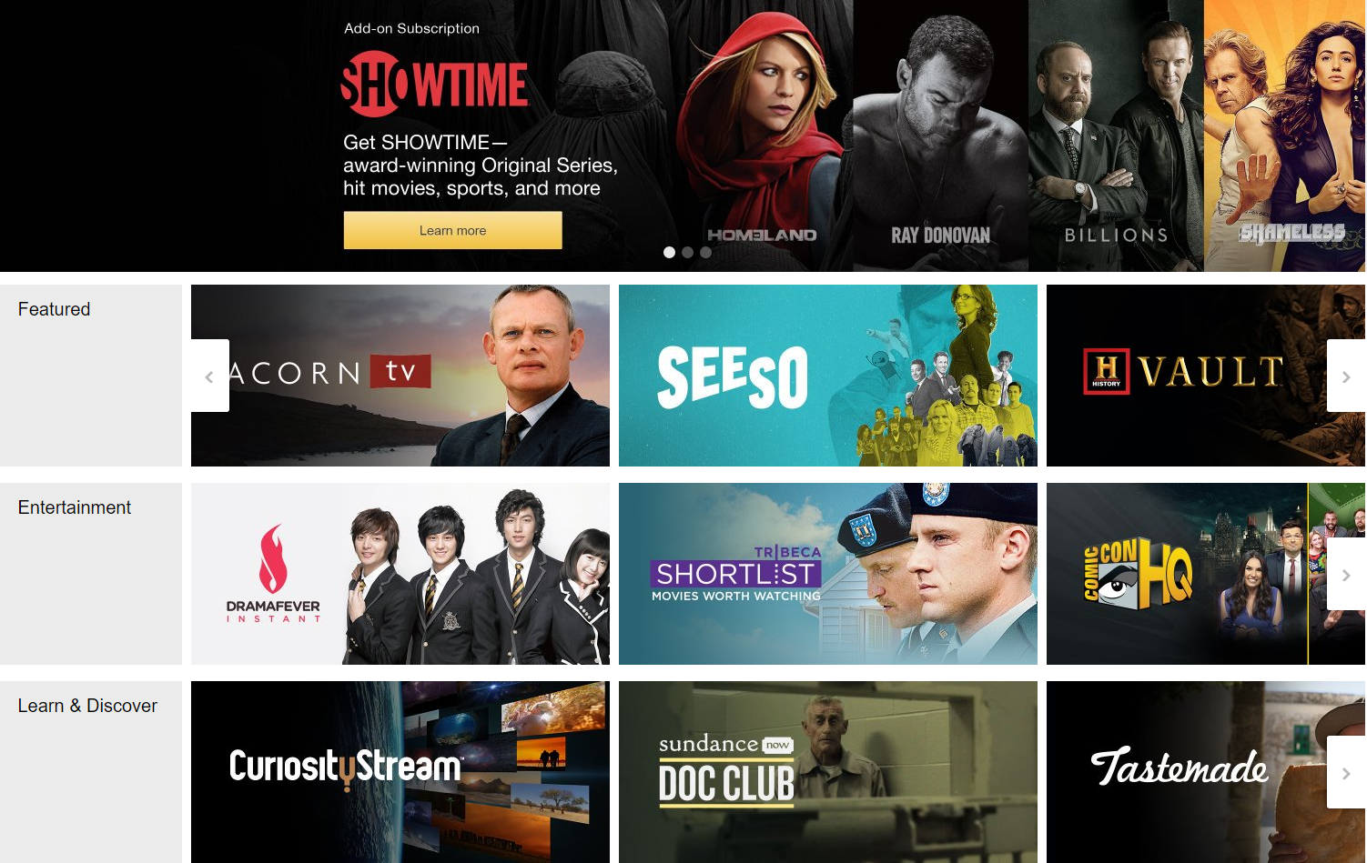
While others are expanding into more niche areas
Streaming partners programme allows niche (or mainstream) VoD services to take advantage of Amazon streaming/billing infrastructure and Prime customer base

Slide 11
SVoD and social video platforms offer additional revenue opportunities
$3.7bn content spend in 2015
$2.9bn to channel owners in 2015

Slide 12
Thanks!

